Slide 1
vTrak
Group 5

Slide 2
Members
Huong Dang
Web – front end
Jacquelyn Law
App front end
Jessica Moreno
Web – front end
Tim Rigby
App back end
Rachael Sera
Web – AJAX/back end
Krystal Siler
App back end
Lorraine Yerger
App front end

Slide 3
vTrak
vTrak
App to track your community service hours & offer new volunteering opportunities .
Set goals and monitor progress.
See recommended volunteer organizations based on your zipcode.
Platform for community service organizations to find potential volunteers .
Notes:
Lorraine

Slide 4
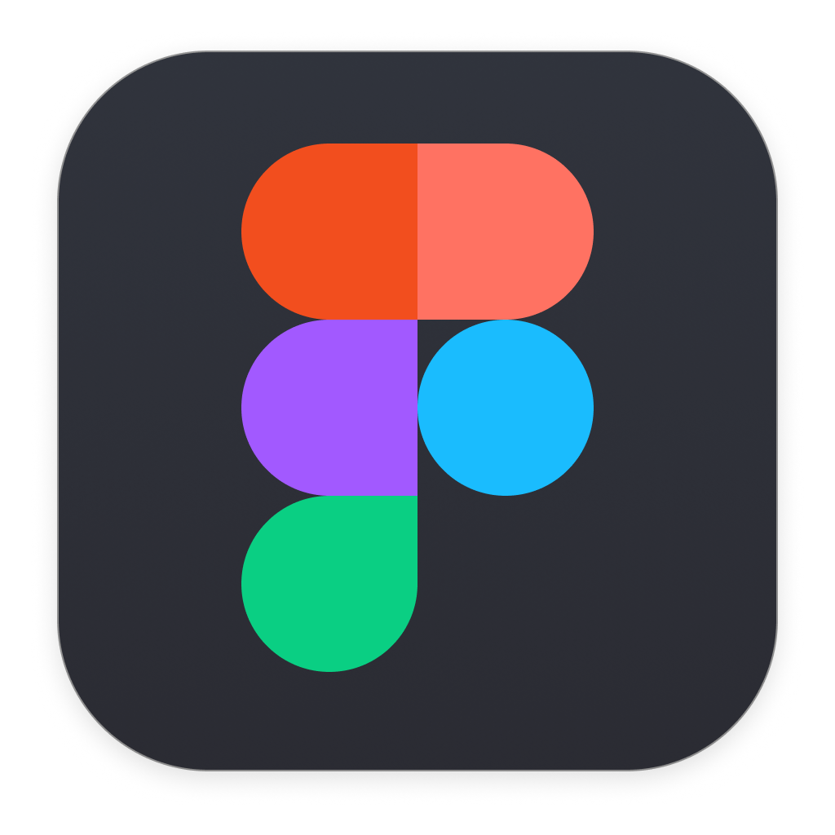
Design
Company brand was inspired by the simple and classic design of contemporary tech trend
UI for app and mobile mocked up with Figma
Web app UI
Inspired by Goodreads' 3-column design/interface
Built with Bootstrap framework
App UI
Built with React Native
Components were built from scratch
Notes:
HUONG

Slide 5
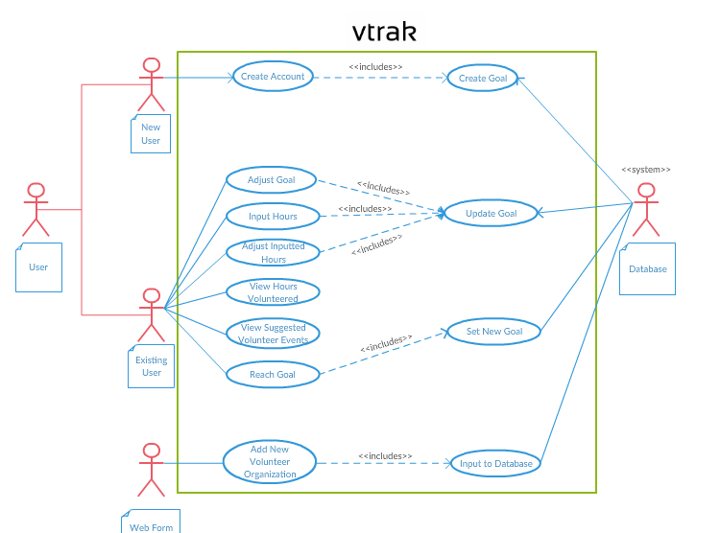
Use Case Diagram

Slide 6

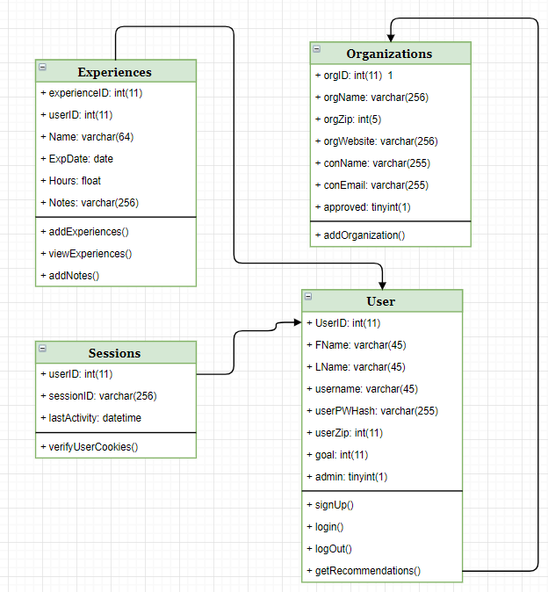
Class Diagram

Slide 7
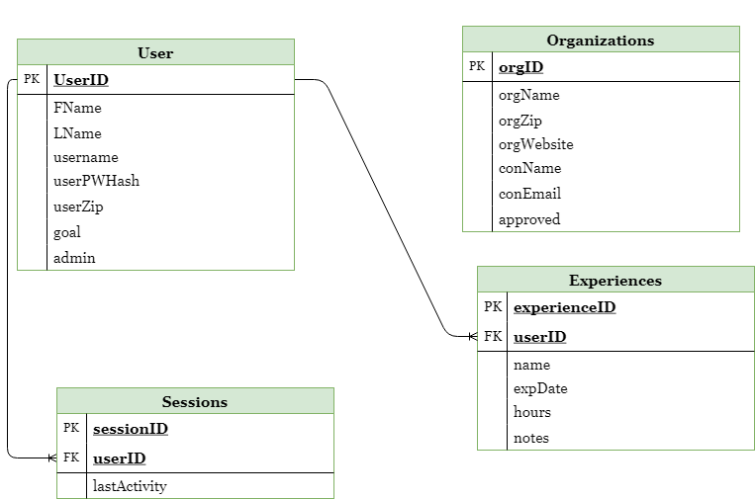
Entity Relationship Diagram
Notes:
Huong

Slide 8

Web
WAMP stack
Hosting by GoDaddy

Slide 9

Mobile
Front end: React Native
Back end: PHP
Notes:
TIM Learning React Native—Udemy. Since we were using WAMP for the website, we wanted to be able to reuse as much of that as possible for the mobile app. We used react native for the frontend, and we were able to use php and MySQL for the backend and database. React Native was completely new territory for I and all of the mobile team, so we had a lot of learning to do before we could start throwing down any code for our app. Krystal found a really great course on Udemy for React Native and it ended up being invaluable, without that I wouldn't have been able to understand anything. There was a lot to learn, had to go through a good amount of the course for a while until we had enough understanding to split off and begin making our app. It paid off, as we were ultimately able to reuse a good amount of our website's backend with slight modifications for our app.

Slide 10
Security
bcrypt password hashing
SQL injection
Sessions table
Cross-site scripting
Notes:
Passwords are hashed and salted using the bcrypt function. Bcrypt is the industry standard most secure hashing algorithm. It stores the salt as part of the hash string (instead of storing it in a separate column) and it extracts the salt from the hashed string.
All user input is escaped for protection against SQL injection.
We also added a sessions table to our database to prevent API abuse and modification of other users' data. All sessions are logged in the DB along with the last activity. When you log in, the userID from the user table is put into the session table along with a randomly generated UUID for the sessionID. The userID and sessionID are then stored in a cookie
They are provided with every request to the API.
If a record is not found in the sessions table matching the IDs in the cookie, the request is rejected
Last activity is logged so that old sessions could potentially be dropped recurring script (future development). Successful actions update the time of the lastActivity.
We also added protection against cross-site scripting. Any value entered into the database could contain script tags. We sanitize all data coming from the database that is rendered to the page to tags and quotes. This is essentially the opposite of SQL injection. It also allows the user to non-maliciously enter a quote mark in a field (e.g. notes) without causing errors.

Slide 11
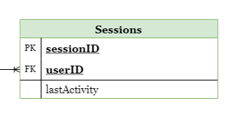
Sessions Table
Notes:
All sessions are logged in the DB along with the last activity. Prevents API abuse by ensuring that an attacker can't modify other users' data.
When you log in, the userID from the user table is put into the session table along with a randomly generated UUID for the sessionID
The userID and sessionID are then stored in a cookie
They are provided with every request to the API.
If a record is not found in the sessions table matching the IDs in the cookie, the request is rejected
Last activity is logged so that old sessions could potentially be dropped recurring script (future development). Successful actions update the time of the lastActivity.

Slide 12

Testing
Targeted Areas:
Internal
User acceptance
Installation
Notes:
Jessica
1. For internal testing, we checked if the front-end worked efficiently with the back-end,
as well as if the database connected, stored and sent out data properly.
The app team used the emulator for testing before uploading the code to the server for updates,
whereas the web team tested on their local host before uploading to the GoDaddy server.
2. Regarding user acceptance, we tested the ease and appearance of the web and app navigation,
to lead a user to be more likely to use vTrak.
3. Installation of the website and app onto the server was tested by
uploading our files to the server and testing each component as a user would,
on different browsers and systems. The downloading of the app to an android device
was a simple download and was tested for navigation and appearance as well.

Slide 13
Issues Encountered
React Native is difficult to learn
Learning to use React Native tools
Emulator is very slow to run – fixed by viewing on phone
Had to learn to handle iOS and Android issues
Build components from scratch
Notes:
JACKIE Our plan was to re-use the php code from the backend of the website for the app, but we did have to make some modifications. For example, the website needs to return data to display, while the app....
Ios only works with https requests, we were using http requests
Learning to use React Native tools like Debugger and Error Log
Issues encountered by ios developers not the same as issues encountered by android developers

Slide 14
Triumphs
Utilizing React Native tools
Building from ground up provides a thorough learning experience
Able to learn ios and Android mobile development
Functional web and mobile application
Notes:
Jackie: Mobile app is built from scratch, wanted to start with a thorough understanding of React Native and its respective tools (like error log)
We have all learned SO MUCH

Slide 15
Improvements for Future
More robust recommendations
Wider zip code range, add interest section
Cleaner UI
All React Native components created from scratch
Data visualization for hours worked at different locations
CAPTCHA verification for organization signup on web app
Link to social media
Notes:
Lorraine

Slide 16
Demo
aptimage.net

Slide 17
Questions?

